Slide 1
Aravindhan V 711721244005 III B.Tech CSBS KGiSL Institute of Technology
CAPSTONE PROJECT
STOCK PRICE PREDICTION
Final Project
Presented By
3/21/2024 Annual Review

Slide 2
PROJECT TITLE
STOCK PRICE PREDICTION
3/21/2024 Annual Review

Slide 3


AGENDA
1. Problem Statement
2. Project Overview
3. End Users
4. Solution and Value Proposition
5. The Wow Factor in Your Solution
6. Modelling
7. Results
3/21/2024 Annual Review

Slide 4

PROBLEM STATEMENT
Dynamic landscape of financial markets, predicting stock prices remains a challenging endeavor, yet it holds significant implications for investors, traders, and financial institutions alike. The ability to accurately forecast stock prices can empower stakeholders with insights to make informed investment decisions, optimize portfolio allocations, and mitigate financial risks.
Despite the plethora of historical data, sophisticated analytical tools, and advanced machine learning algorithms at our disposal, stock price prediction remains fraught with uncertainties due to the complex interplay of numerous influencing factors. These factors encompass a broad spectrum, ranging from macroeconomic indicators, geopolitical events, and industry-specific trends to psychological biases and market sentiment.
3/21/2024 Annual Review

Slide 5

PROJECT OVERVIEW
The primary objective of this project is to develop a robust and accurate predictive model for forecasting stock prices, leveraging advanced machine learning algorithms and techniques.
In the volatile and complex world of financial markets, predicting stock prices has long been a focal point for investors, traders, and financial analysts. Accurate stock price predictions can provide valuable insights for making informed investment decisions, optimizing portfolio strategies, and mitigating financial risks.
3/21/2024 Annual Review

Slide 6

WHO ARE THE END USERS?
Individual investors: Retail investors who manage their own investment portfolios.
Institutional investors: Hedge funds, mutual funds, pension funds, and other large investment firms.
Day traders: Individuals who buy and sell stocks within a single trading day to capitalize on short-term price movements.
Swing traders: Traders who hold stocks for a short to medium-term period, typically from a few days to several weeks, aiming to profit from price swings.
Equity analysts: Professionals who analyze financial data, market trends, and company performance to provide investment recommendations.
Quantitative analysts (Quants): Analysts who use mathematical and statistical models to develop trading strategies and risk management tools.
3/21/2024 Annual Review

Slide 7

YOUR SOLUTION AND ITS VALUE PROPOSITION
Utilizes sophisticated machine learning models to analyze historical stock data, market trends, and other relevant factors to forecast future stock price movements with high accuracy.
Offers real-time stock price updates and predictions, allowing users to monitor market changes and adjust their strategies promptly.
Enables users to set personalized alerts based on specific stock price thresholds or prediction outcomes, ensuring timely notifications for potential trading opportunities or risk mitigation.
3/21/2024 Annual Review

Slide 8

THE WOW IN YOUR SOLUTION
Our platform features a dynamic learning engine that continually adapts and evolves, learning from market dynamics, user interactions, and real-world events to refine its predictive capabilities over time.
Beyond mere numbers and predictions, our platform delivers intuitive insights that provide deeper understanding and context.
Imagine having a personal AI assistant that understands your unique investment goals, risk tolerance, and preferences.
3/21/2024 Annual Review
8

Slide 9
MODELLING
A popular statistical method for analyzing and forecasting time-series data. It captures different aspects of time series data like seasonality, trend, and noise.
A simple model that establishes a linear relationship between the dependent and independent variables.
A class of neural networks designed for sequential data that can capture temporal dependencies in time-series data.
3/21/2024 Annual Review
9

Slide 10
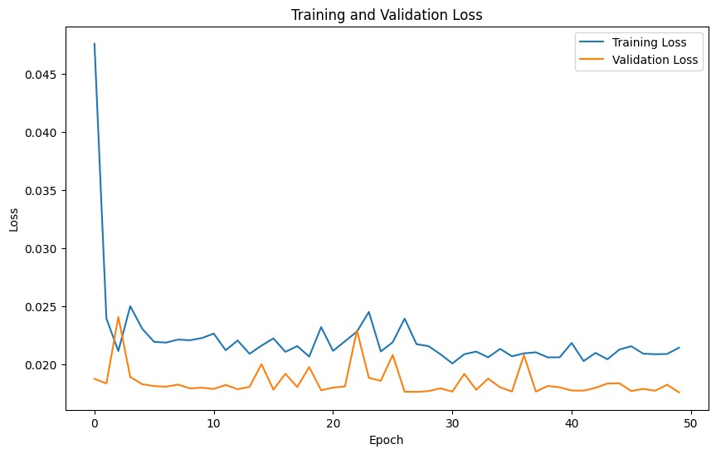
RESULTS
https://drive.google.com/file/d/1IrPQWM3xEQwQ4SzJk_tm11NFAVxCirzu/view?usp=sharing
3/21/2024 Annual Review
10

